Slide 1
IS221 Assignment 2
Creating a Web Site using ASP.NET Technology
GROUP 65:
Shahil Avishal Pravind (S11132814)
Arnesh Chandra (S11136344)
Nalisha Ashwini Singh (S11132476)
Kritesh Krishan Prasad (S11134426)

Slide 2
INTRODUCTION
Project:
Creation of a website for Titans Gym, domestic business that specializes in providing gym services to the people of Fiji.
MISSION:
To provide high quality gym service to the people of Fiji that enables them to participate in all forms of physical activity without the compromise of a healthy life.

Slide 3
CONTENT GOALS
BILLBOARD
Primary purpose is to get more customers through advertisements.
Provide current updates about the gym in form of news or important highlights.
Blog
Public Interest

Slide 4
Audience
Individuals who are interested in fitness and a healthy lifestyle.
No age group restriction however, mainly 18 – 40 targeted.
Gender unbiased
Nationality – anyone in Fiji, unbiased

Slide 5
Site content and functional requirements
Gallery
Tutorial Videos
Location Finder
Merchandise
Health Blog
Tutorial Videos
Gym Information
Reviews
Location Finder
Site Registration
Social Media Links
Security measure – discussed later

Slide 6
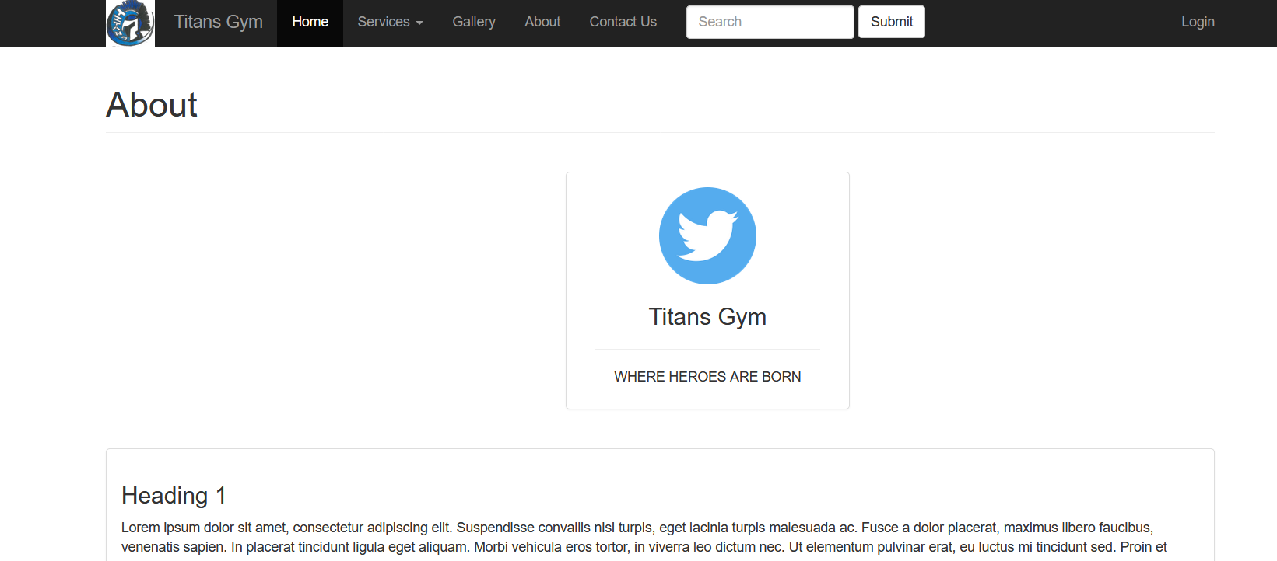
DIFFERENCE:

Slide 7
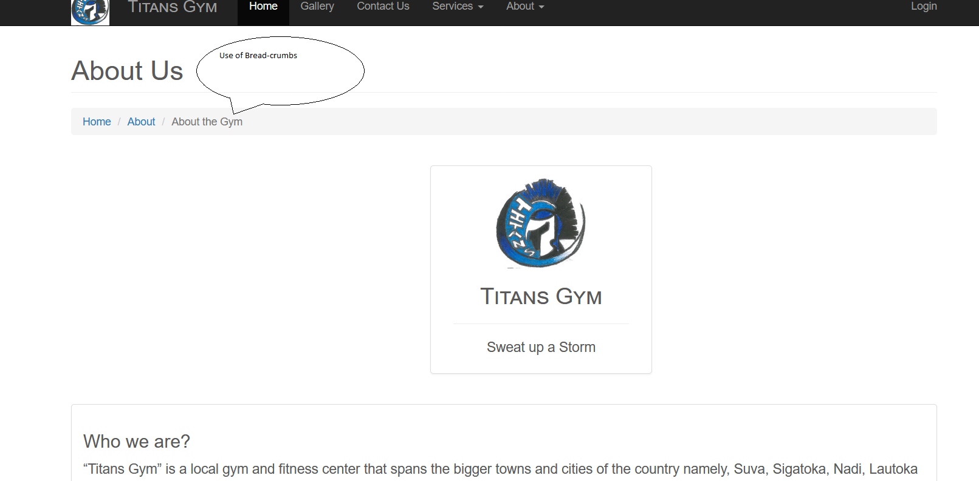
Difference:

Slide 8
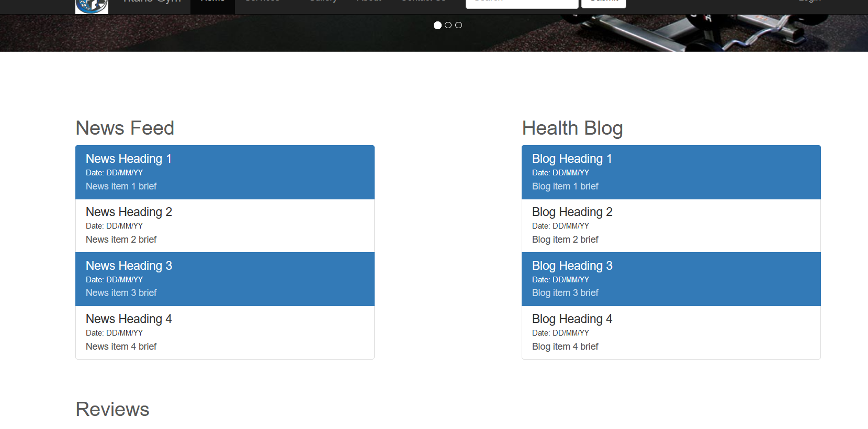
DIFFERENCE:

Slide 9
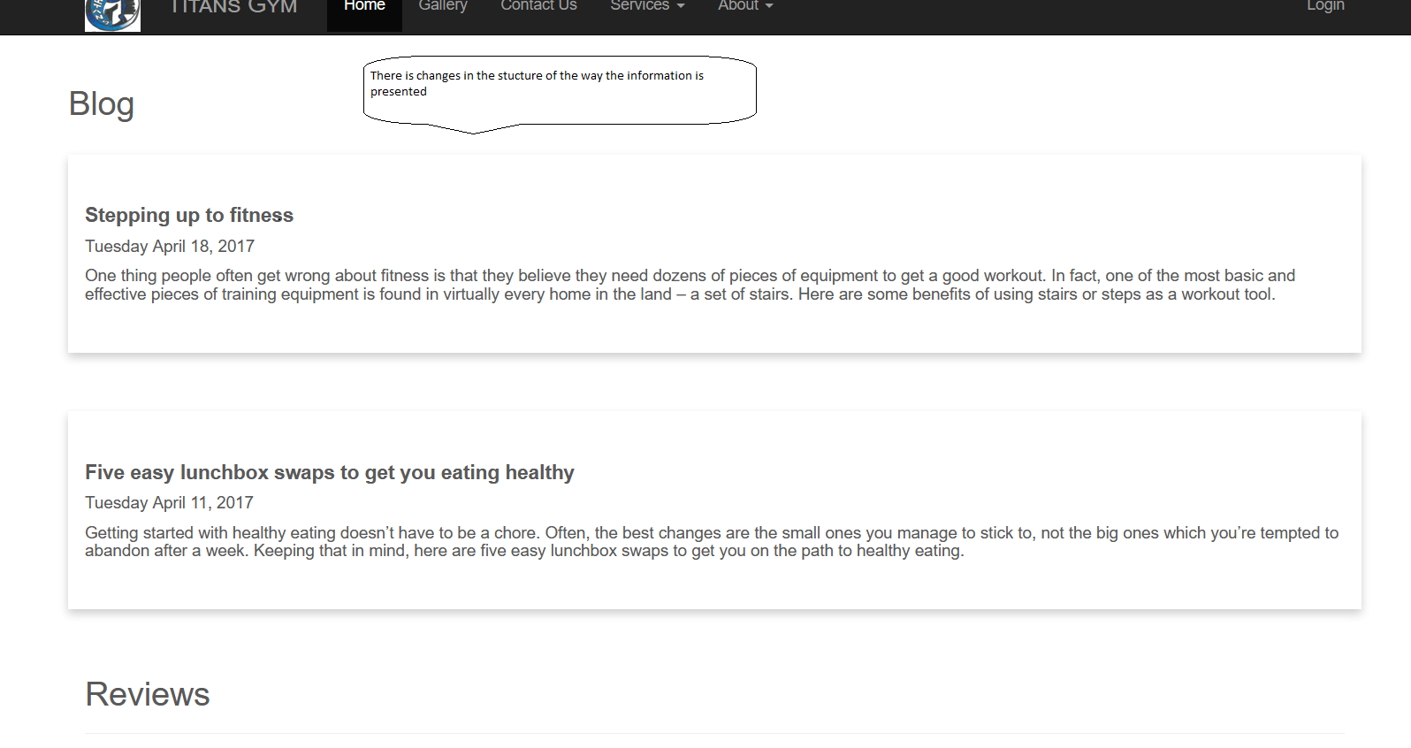
DIFFERENCE:

Slide 10
DIFFERENCE:

Slide 11
DIFFERENCE:

Slide 12
Testing
Tested with:
Waterfox
Firefox
Google Chrome
Microsoft Edge
Best presented in: Waterfox
Issues:
Chrome – brighter view makes for lighter display of website
All – whitespace when viewing in smaller dimensions

Slide 13
Security measures
SQL Injection
Stripping and escaping all user input.
Renaming all uploaded files.
Validating user input especially format of uploaded files.
Use of stored procedures
Use of parametrized queries
List privilege
2. Cross Site Scripting

Slide 14
Security measures
2. Cross Site Scripting
Check standard headers to verify request is same origin.
Check CSRF token.

Slide 15
Video Link
The video is available at the following link:
https://youtu.be/CycQFYKnX2c

Slide 16
QUESTIONS?

